Slide 1
Classifying Veg vs Non-Veg food at Social 704
Aditya Dhawan, Denzel Fowler, Medha Karthik, Chris Pitre
Group 8

Slide 2
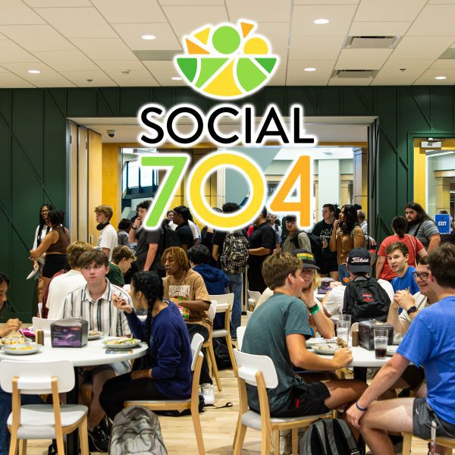
Problem and Motivation
Use an image data source and a computer vision application to classify a given dish at Social 704 as vegetarian or non-vegetarian
Vegetarian dish excludes meat, may or may not include byproducts
Eggs, Cheese, etc.
Motivation- help people with dietary restrictions determine what they are eating
Motivation- classify unknown dish before trying it for the first time
Notes:
Briefly tell the story of the problem you set out
to solve, what you learned about the problem in each of the previous
stages

Slide 3
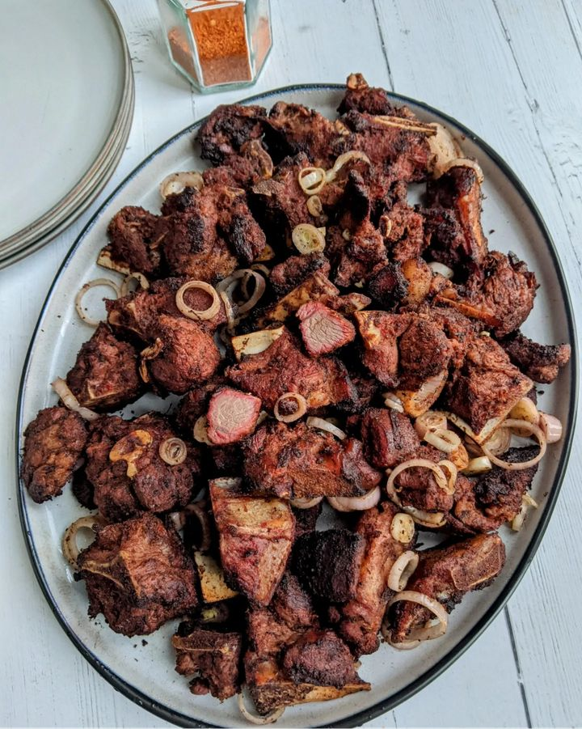
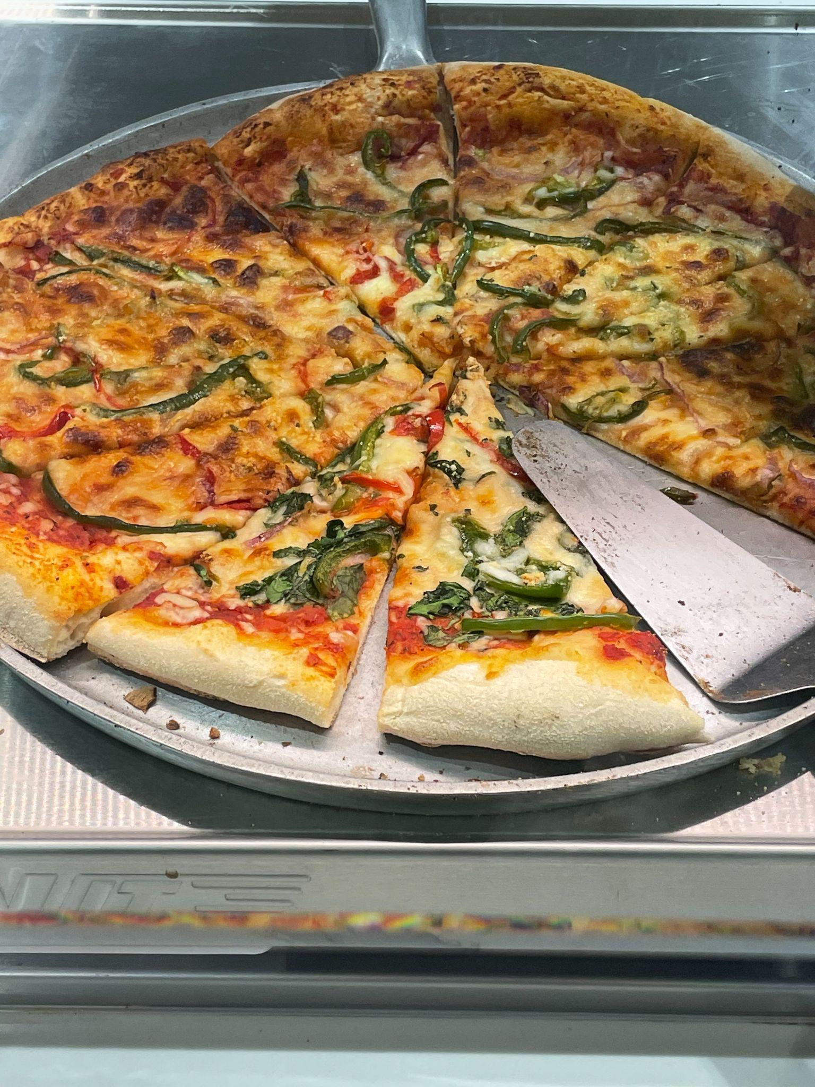
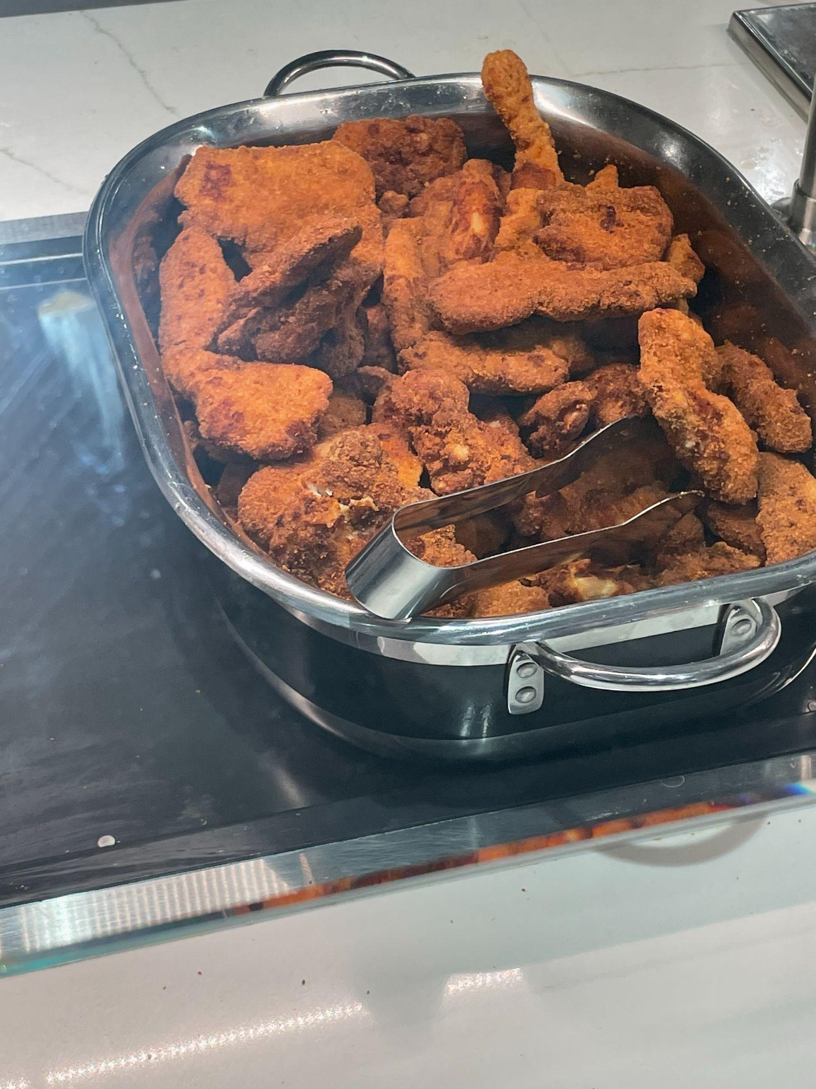
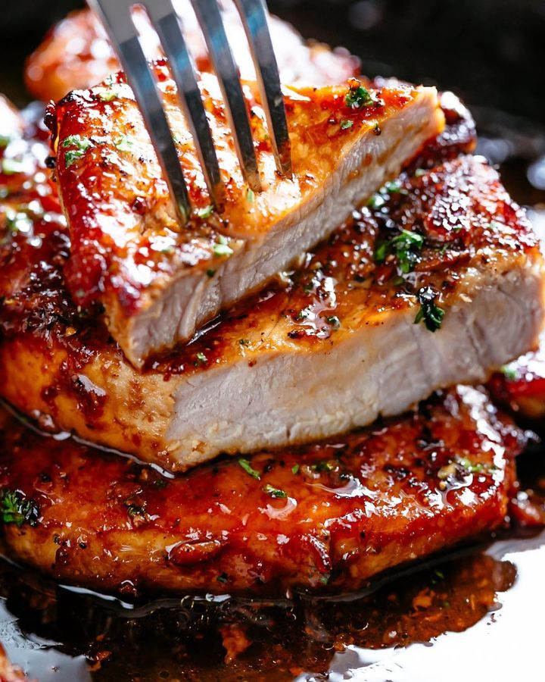
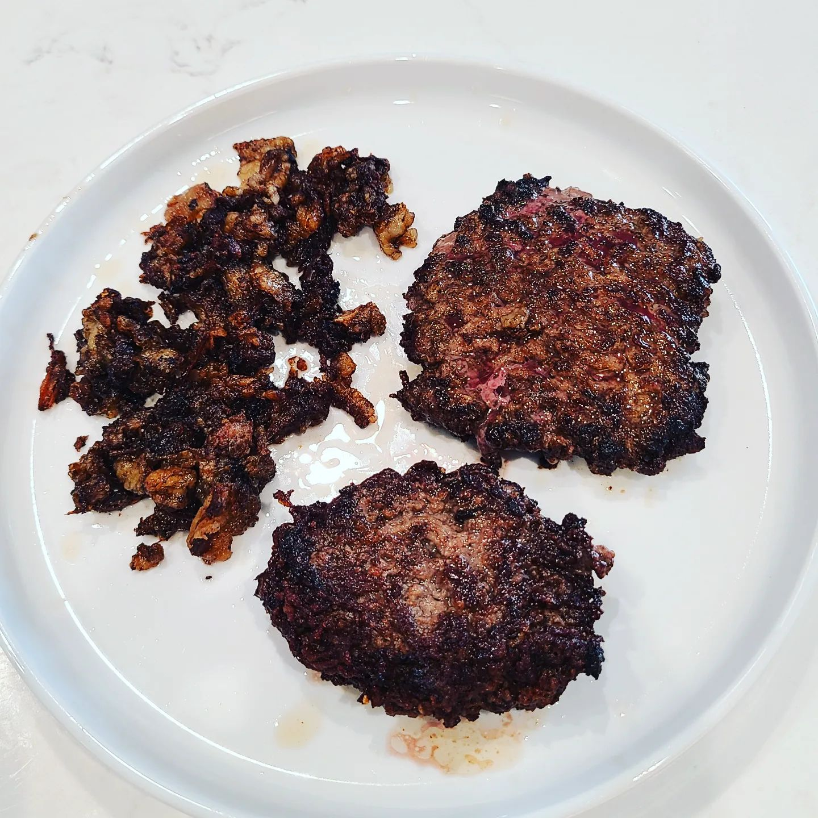
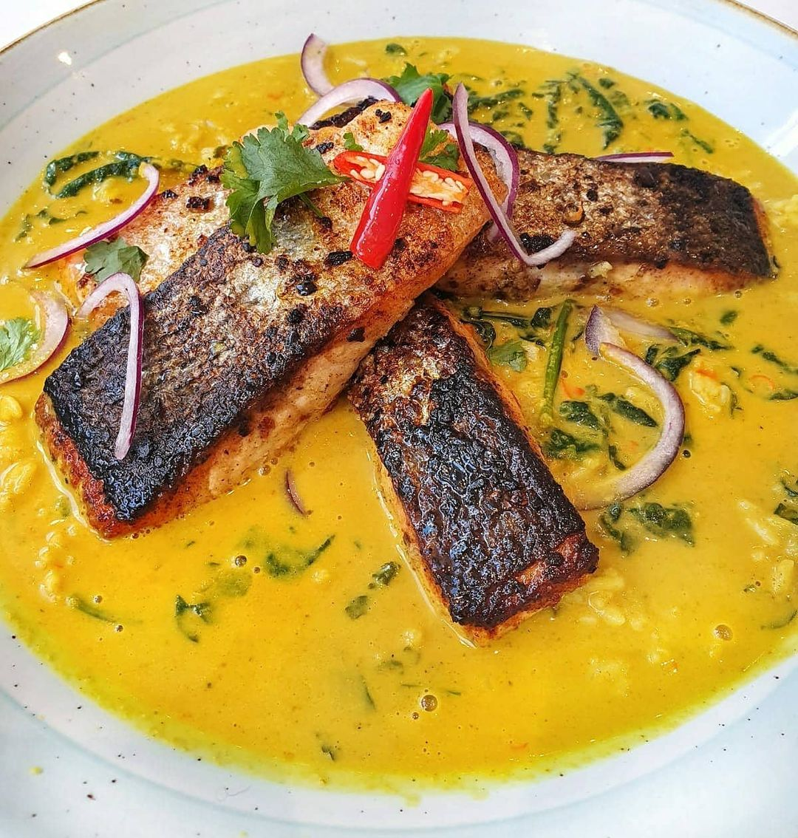
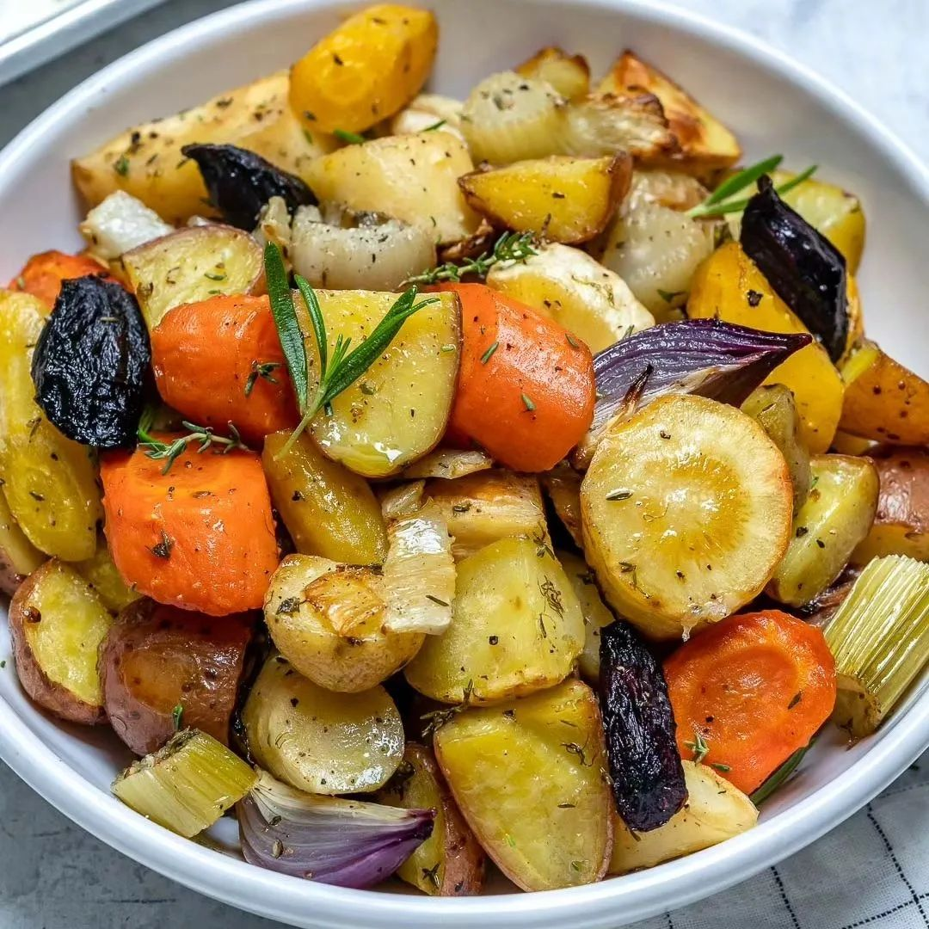
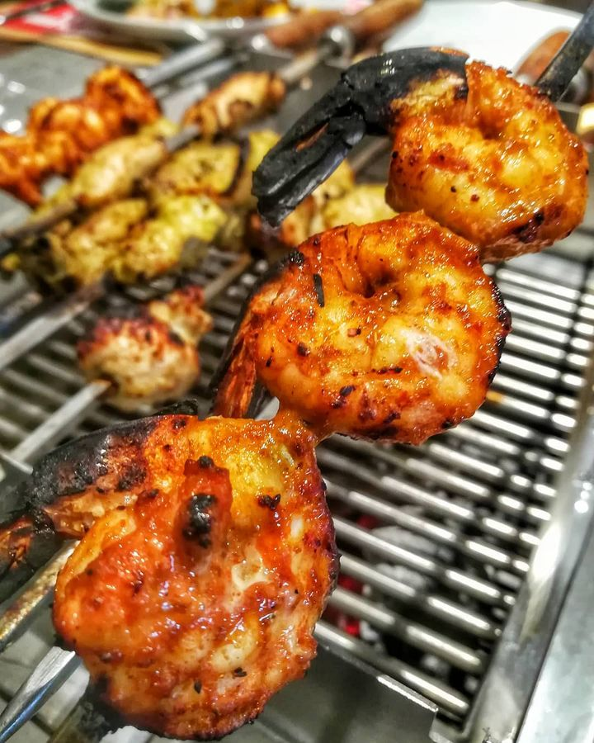
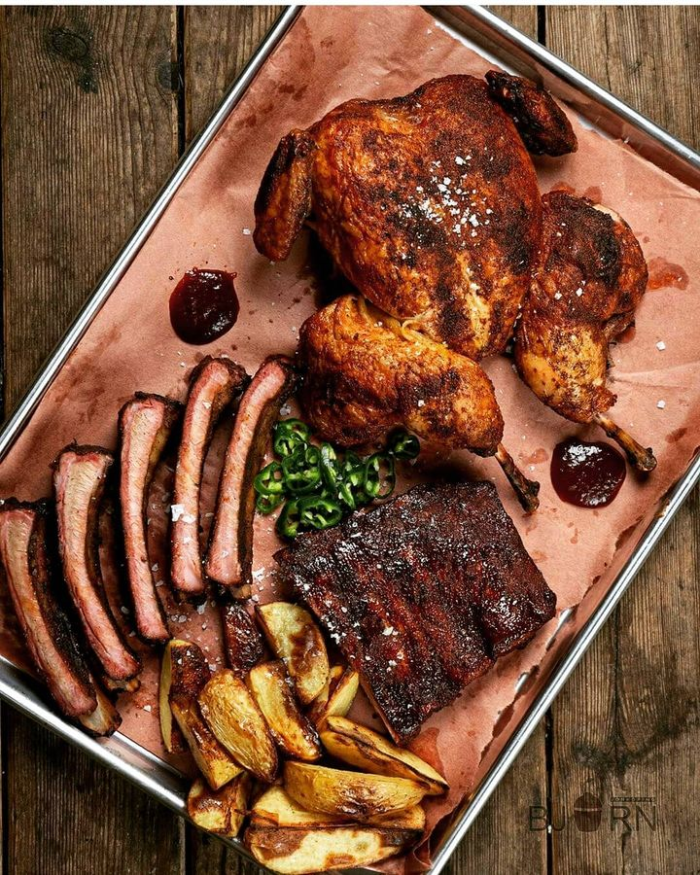
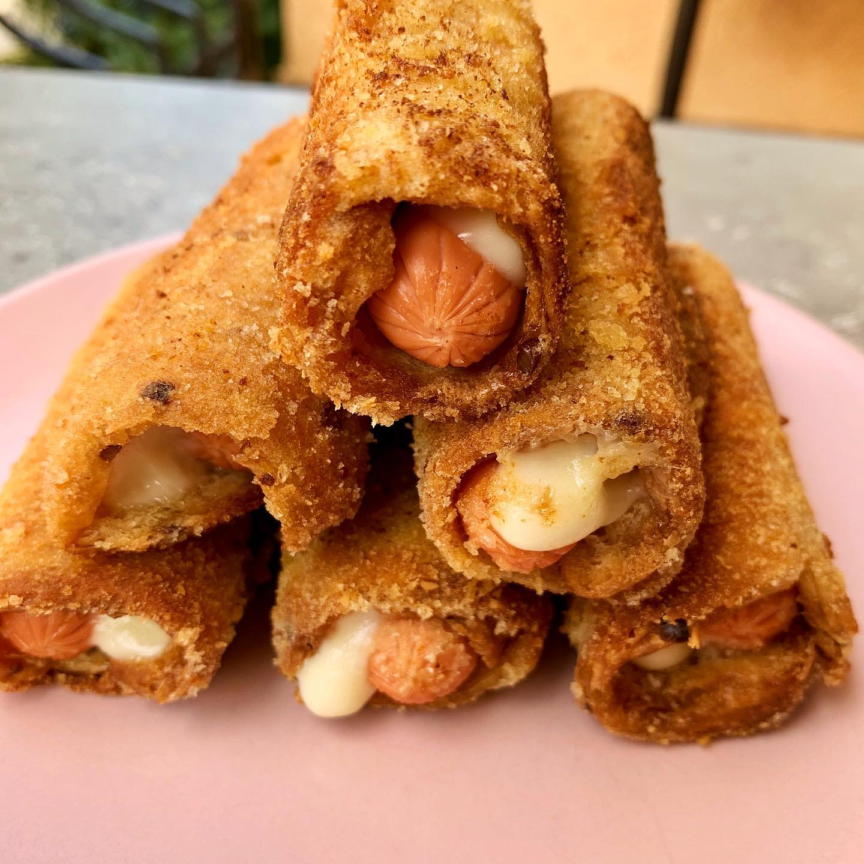
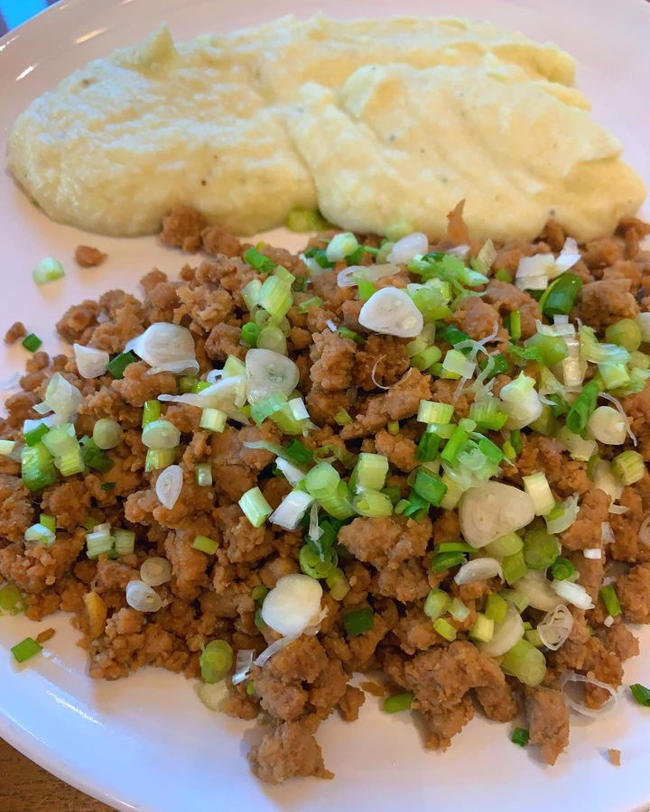
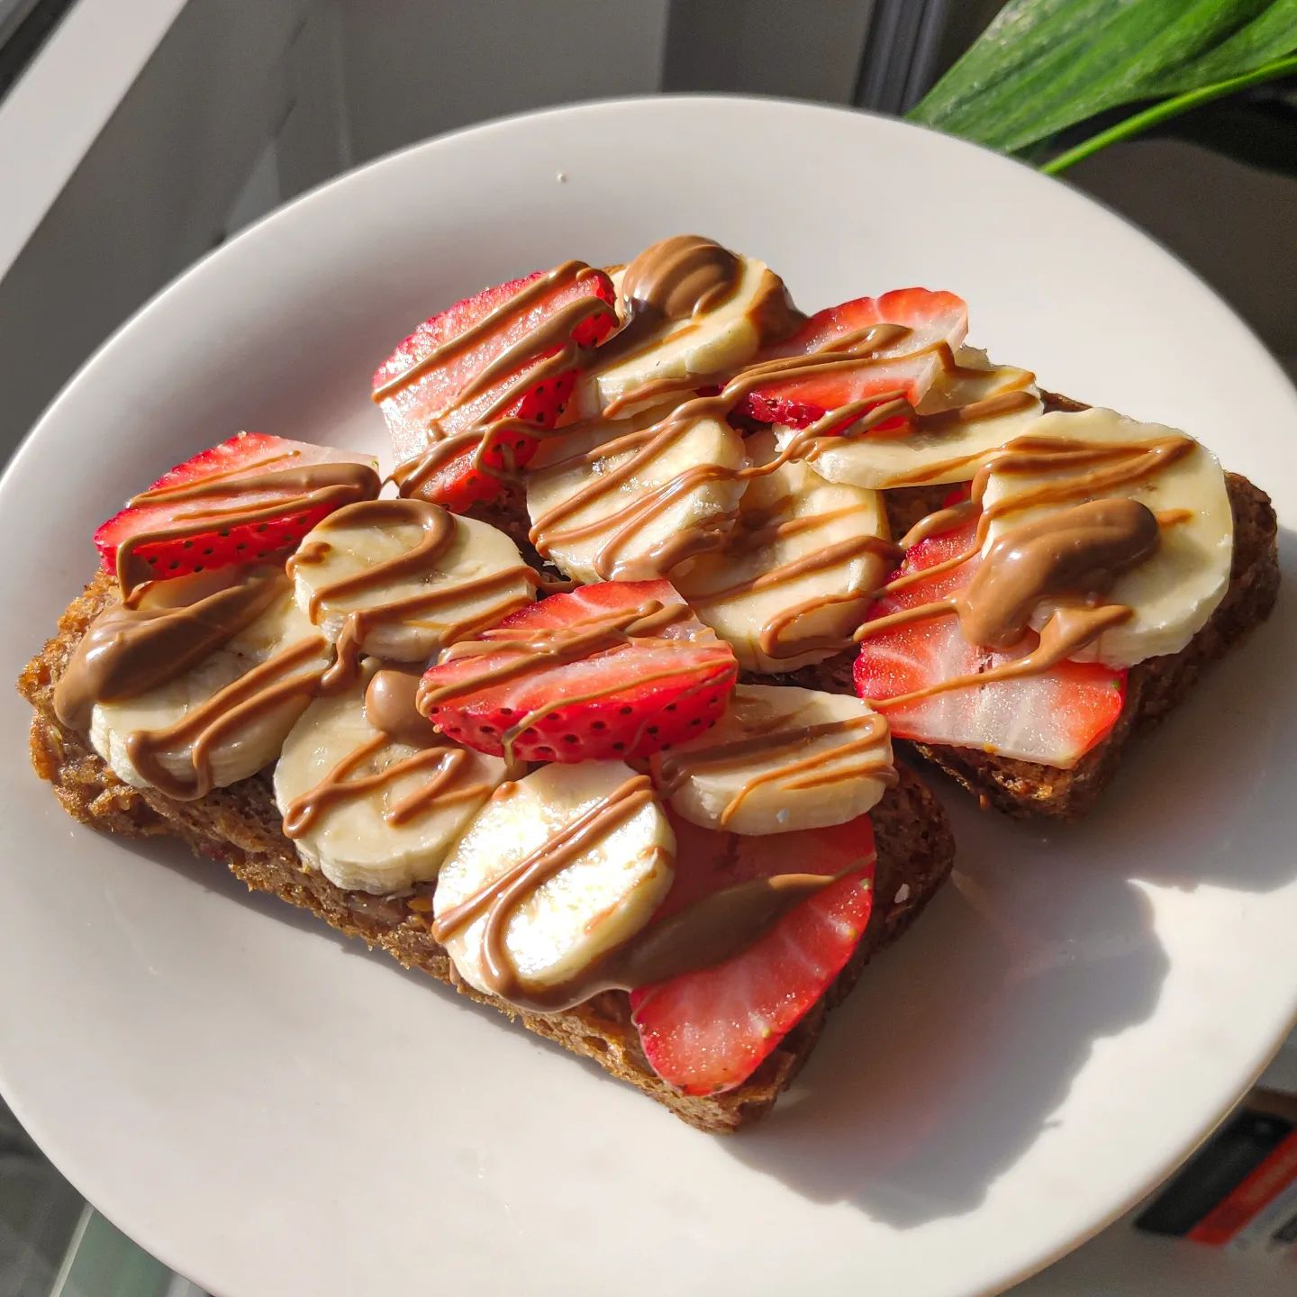
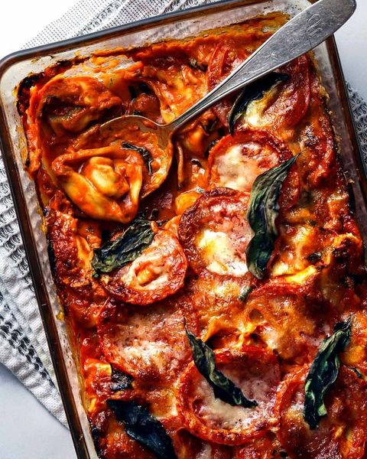
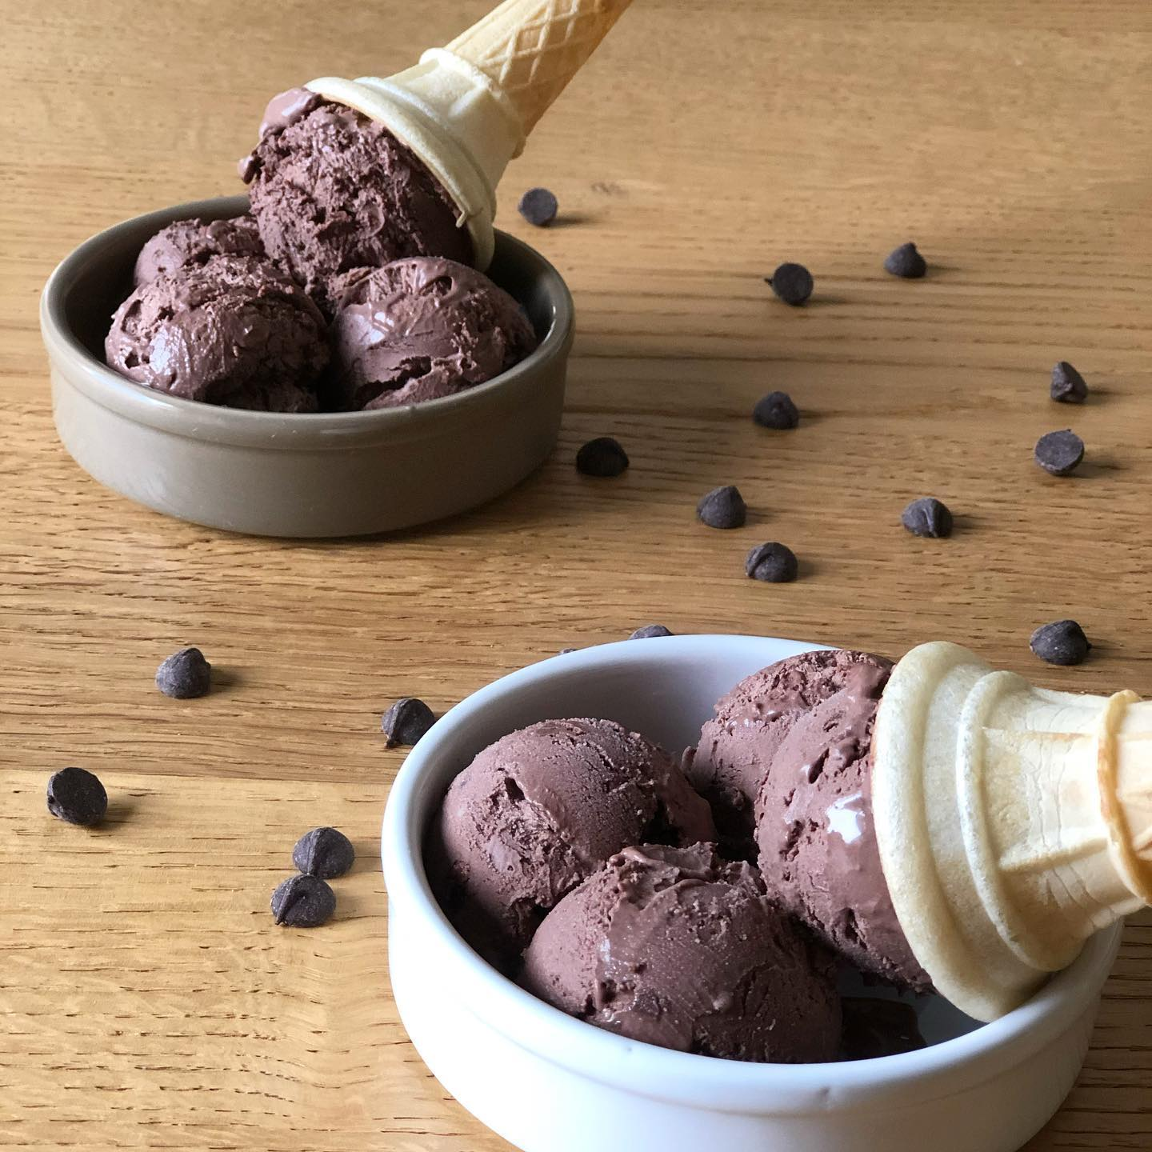
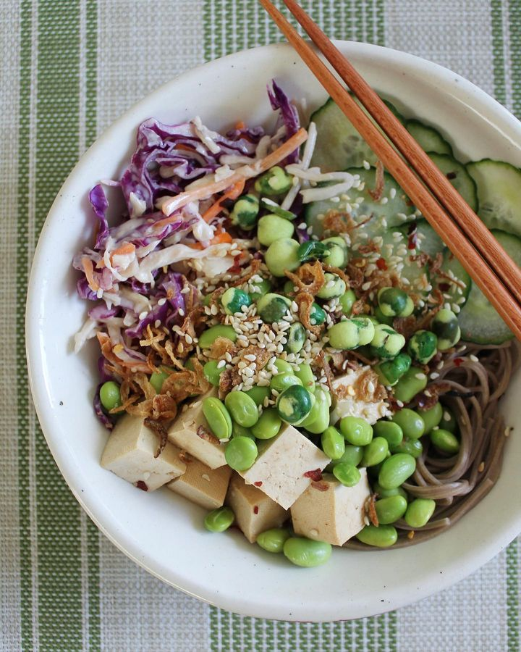
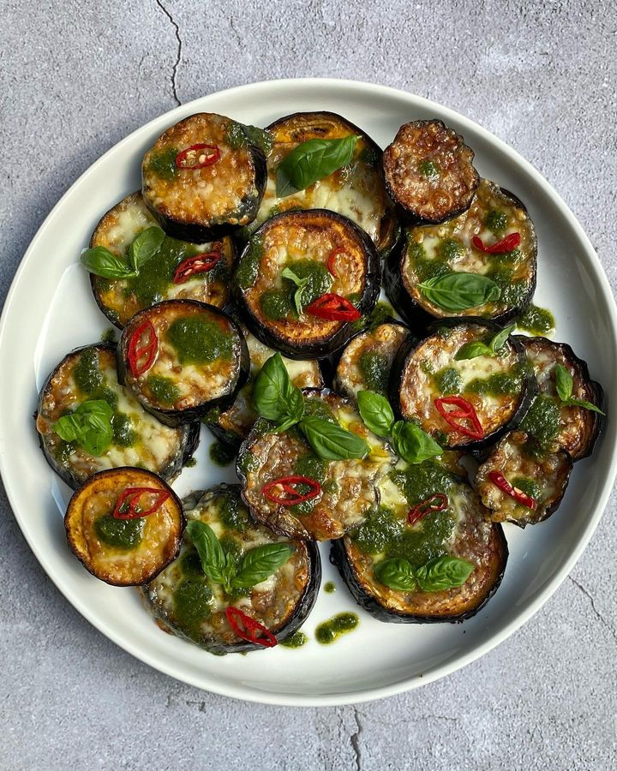
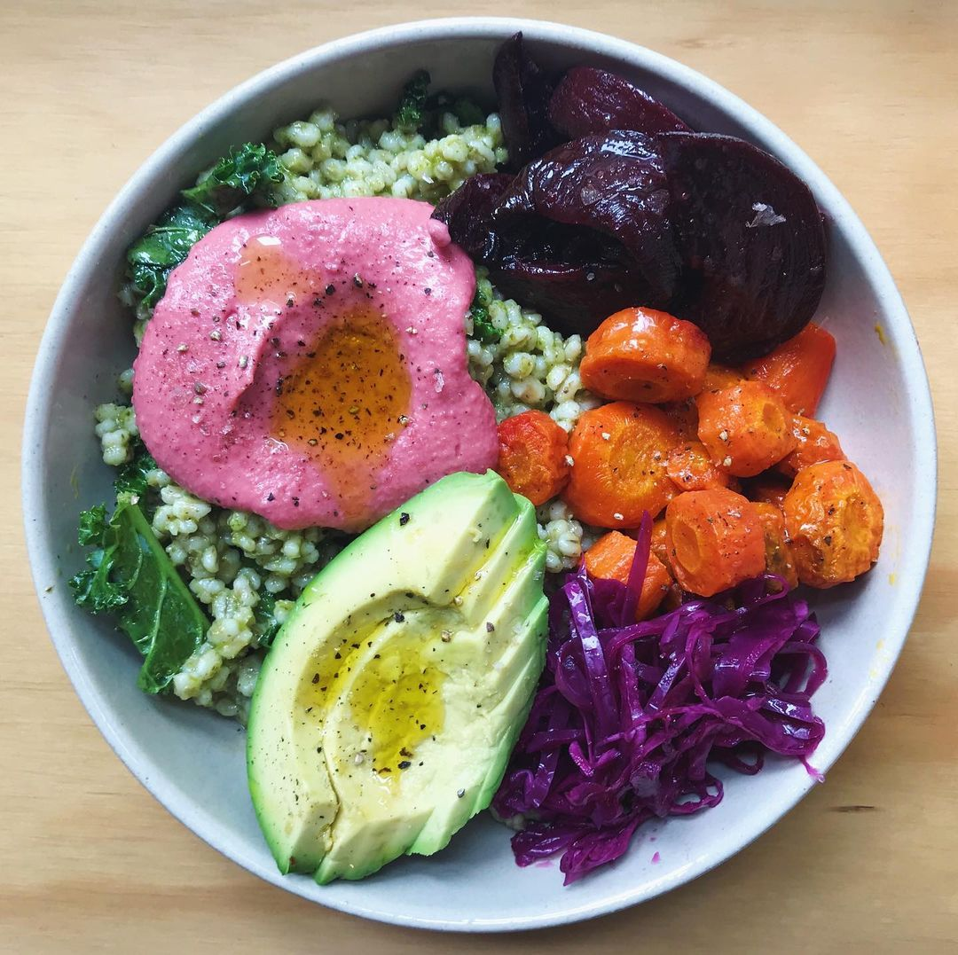
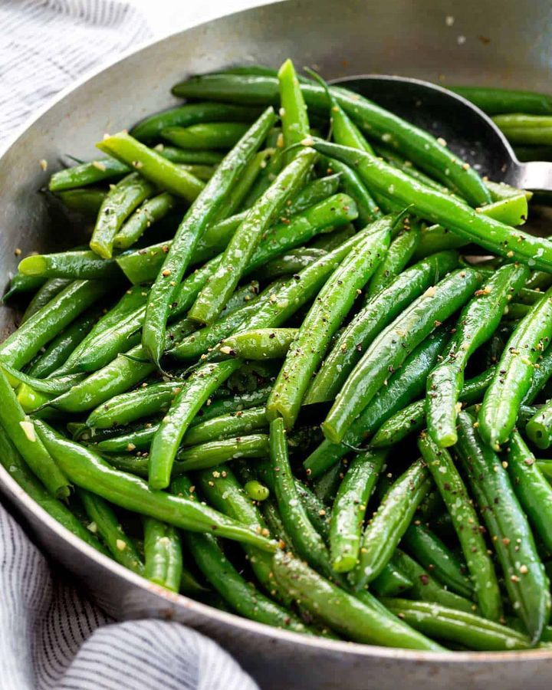
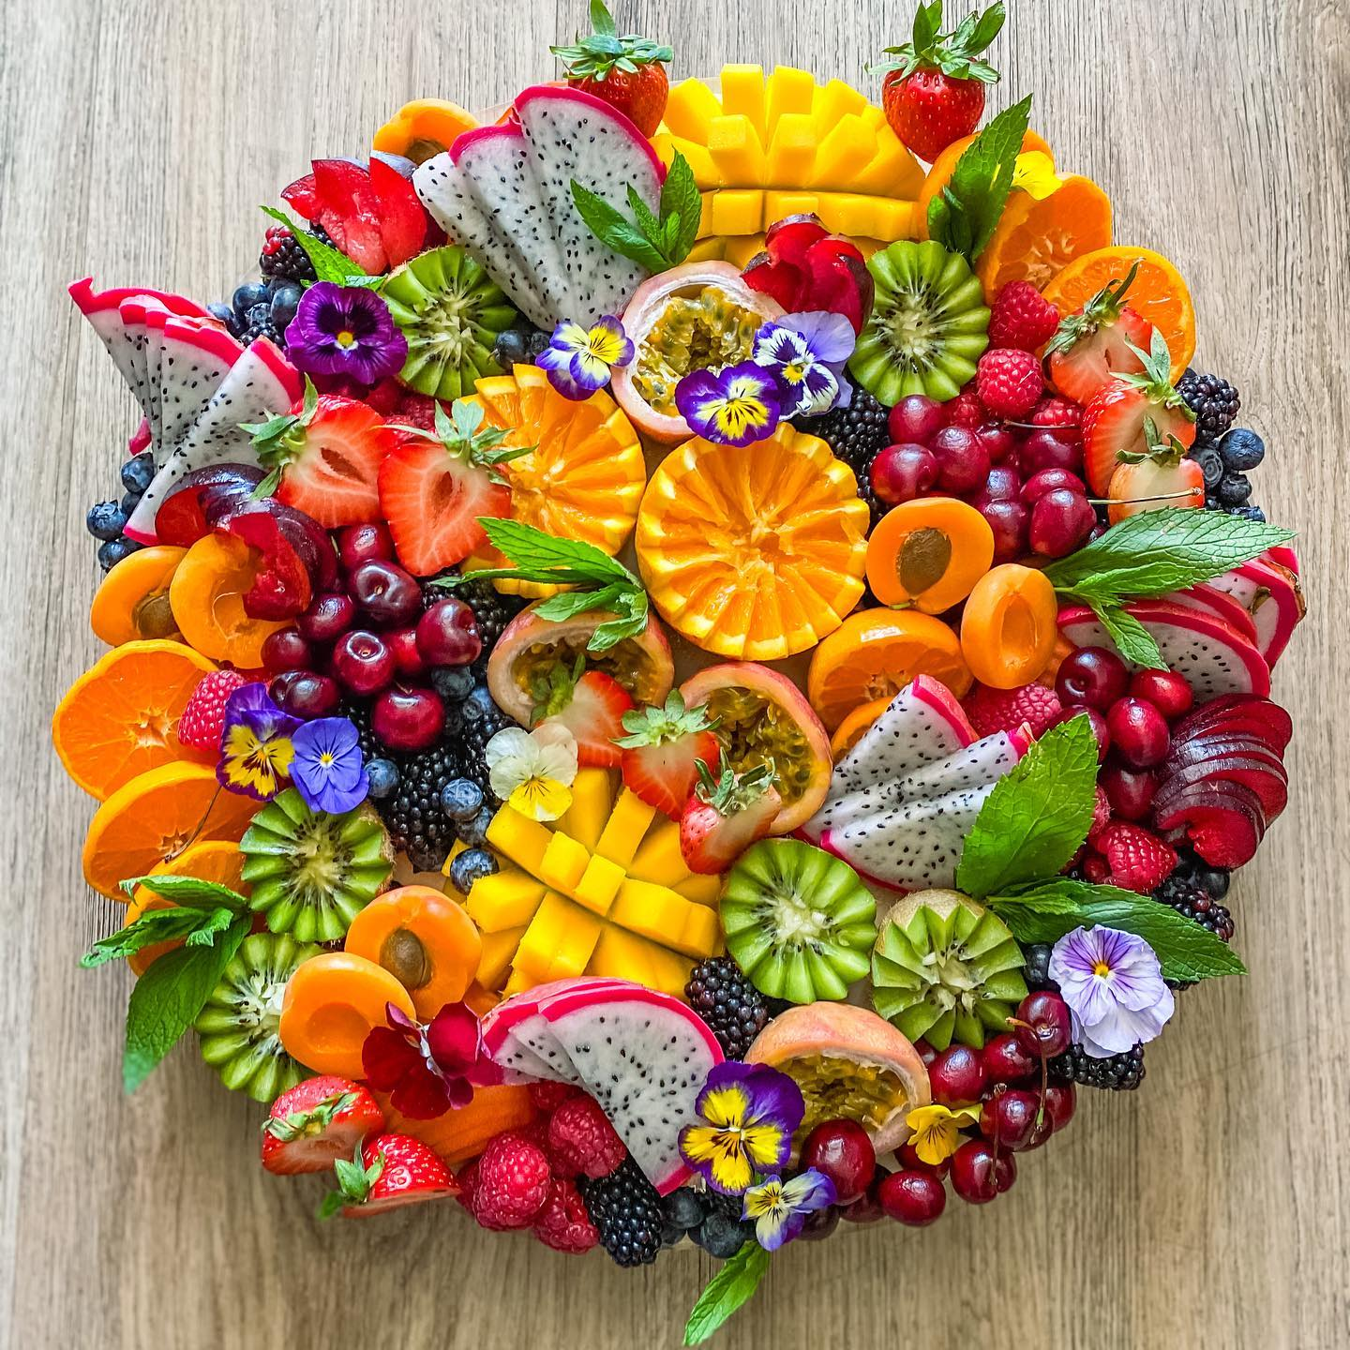
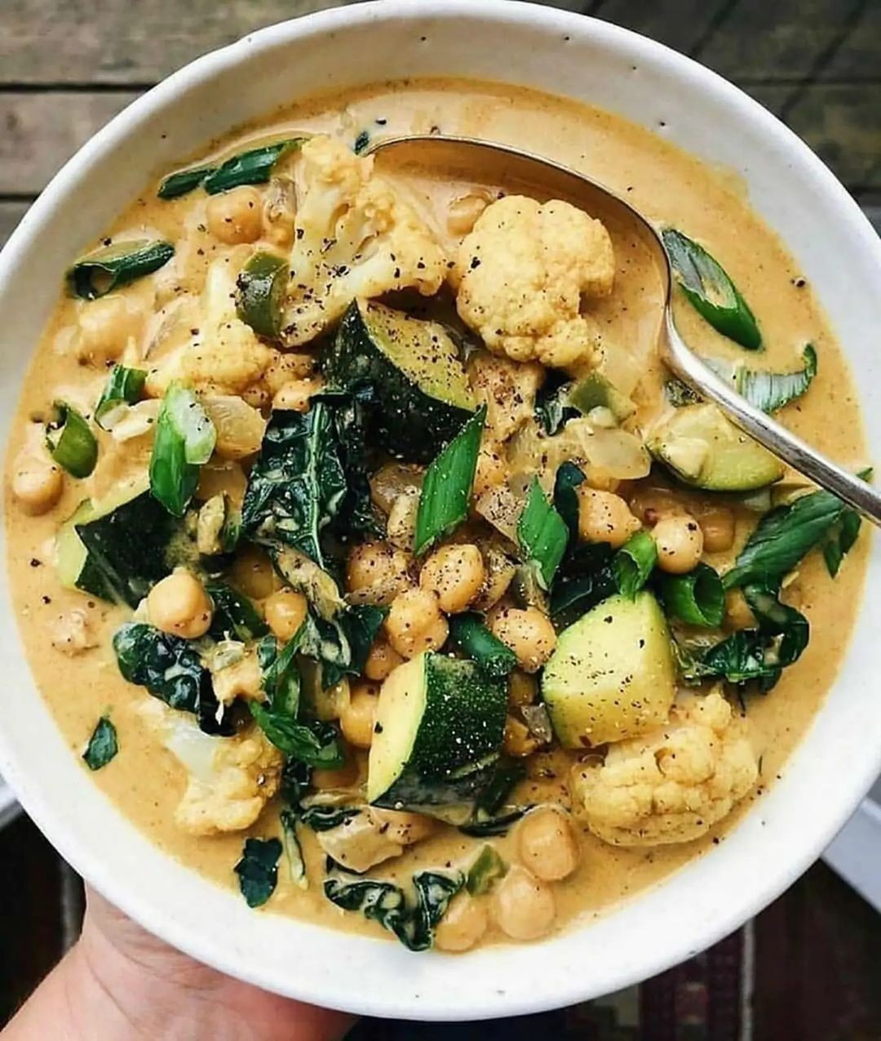
Dataset
Notes:
Used publicly available data taken from UNCC social media and collected data from Social 704
Variety of meals (breakfast, lunch, dinner, dessert) to represent Social 704 food

Slide 4
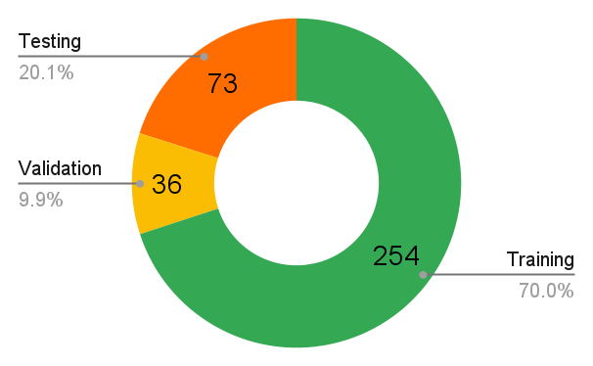
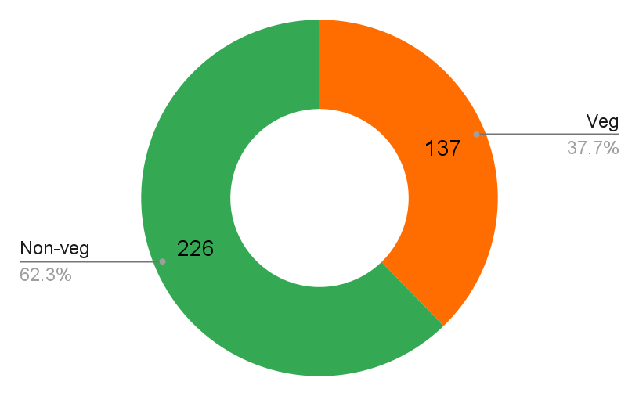
Dataset
Number of samples- 226 non-veg + 137 veg = 363 total
Data is labeled as either vegetarian (0) or non-vegetarian (1)

Slide 5
Methodology
Load a Pretrained Inception v4 model
Freeze all weights except the last layer and replace the last layer with a fully connected layer with one output
Label data as either vegetarian (0) or non-vegetarian (1)
Split data into training set, validation set, and testing set
Augment the images in training set
Trained model with the following Hyperparameters
Learning rate (alpha)- 0.001
Epochs- 25
Momentum- 0.9

Slide 6
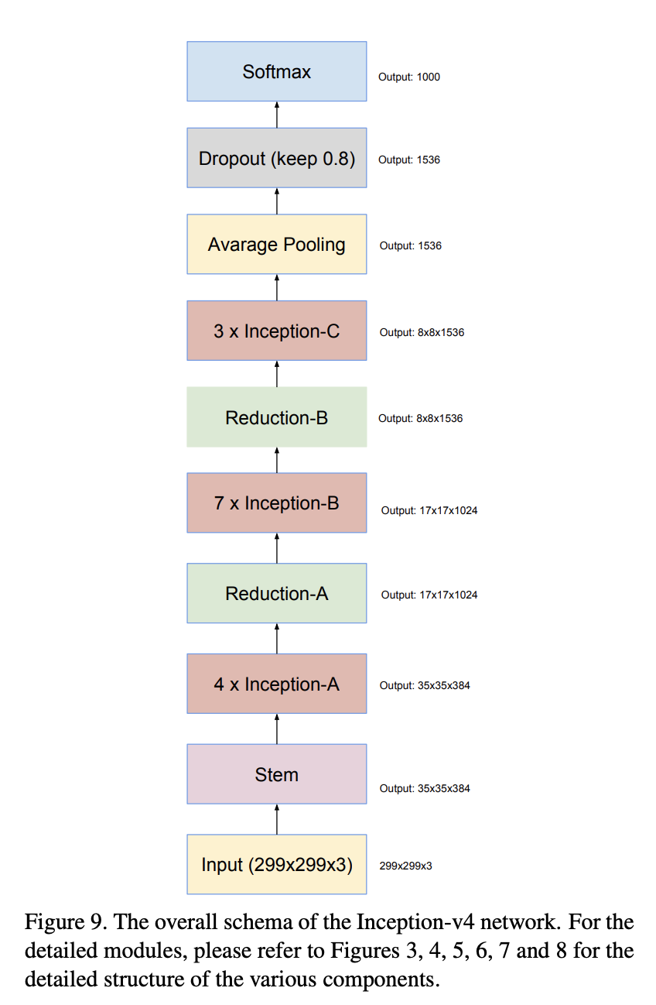
Why Inception v4?
During research, we came across the article “Machine Learning Based Approach on Food Recognition and Nutrition Estimation”
This article documented different methods used in deep learning to recognize food category types
Out of the CNN models they used, Inception-v4 had the best metrics
Inception-v4 was also very scalable
The only downsides were as follows:
Long Training Times
Resource Intensive

Slide 7
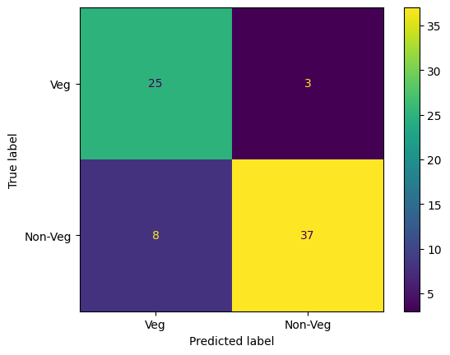
Results
Example Testing Set Output
Accuracy: 84.93%
Correctly classified images out of total
Precision: 92.50%
Ratio of true non-veg images to predicted non-veg images
Recall: 82.22%
Ratio of true non-veg images identified correctly
F1-score: 87.06%
Harmonic mean of Precision and Recall
Shows that the model is correctly distinguishing between non-veg and veg images

Slide 8
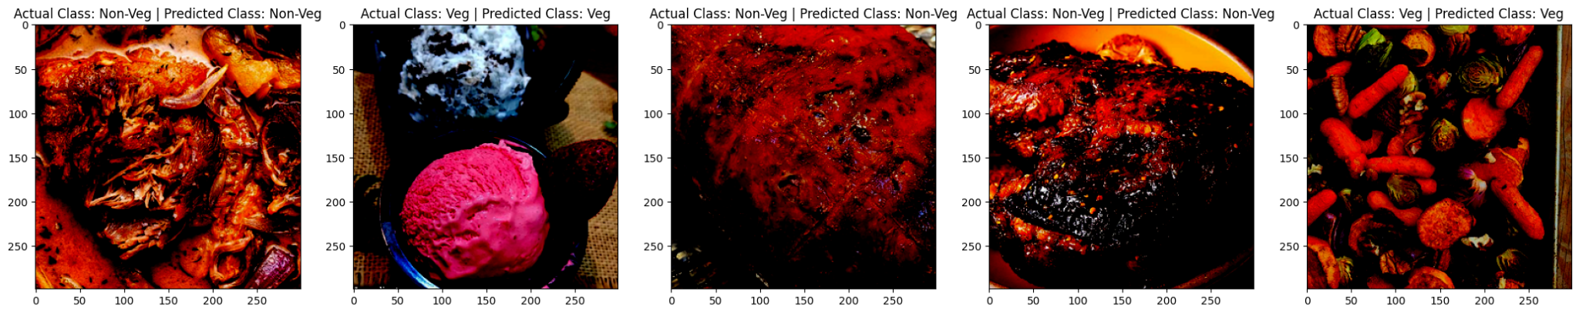

Slide 9
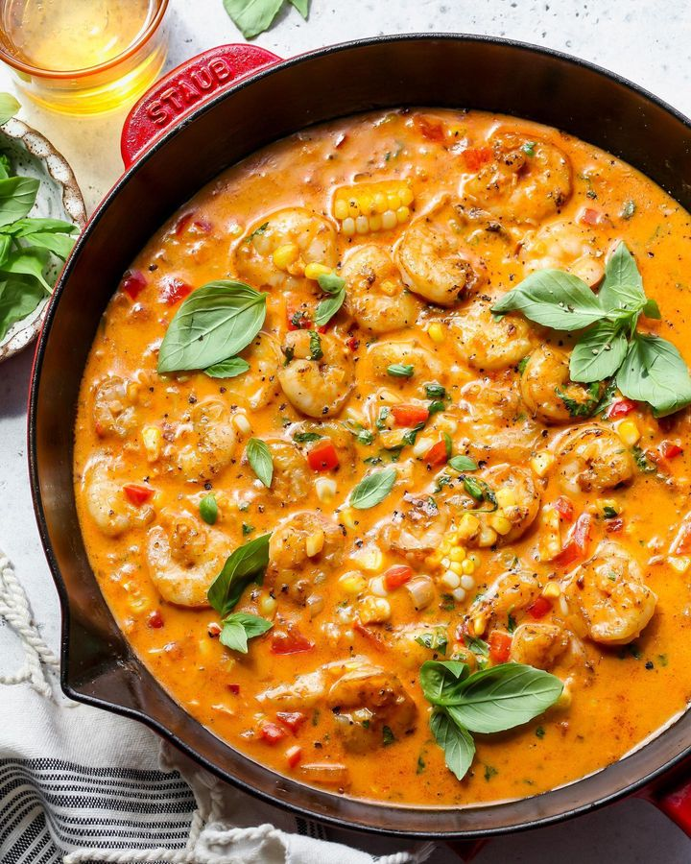
Conclusion
Need a way to distinguish vegetarian vs. non-veg.
Fine-Tune Inception-v4
Basis for experiment: Social 704
Expansion to different chains with different dishes
84.93% accuracy from our data, F1 score = 87.06%
Room for fine-tuning with outliers in data
Ex: Images that appear veg but with “hidden” non-veg portions

Slide 10
Questions?

